Slide 1
TACHOMETER
It
is a simple non contact or contactless digital device using 8051 microcontroller

Slide 2
Introduction
A tachometer is a device which measures the speed of rotating object like an electric motor or a crack shaft of a vehicle engine.
The speed of an electric motor is determined by the number of revolutions made by the motor in one meter.
It is expressed in the unit of RPS (or) RPM.
The individual pulses are counted by the microcontroller to give the final output of the RPM.

Slide 3
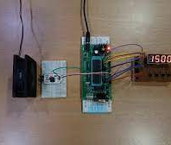
TACHOMETER
It is a simple non-contact or contactless digital device which can measure speed with an accuracy of 1rev/sec.

Slide 4
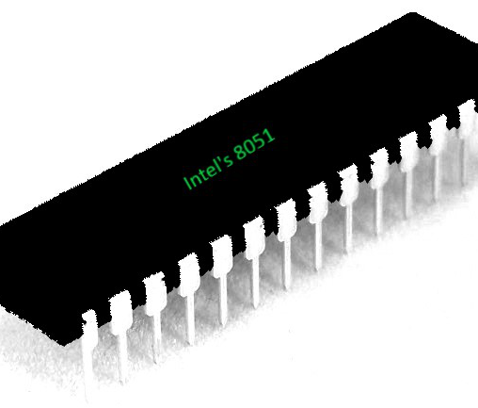
8051 Microcontroller
A microcontroller is a compact integrated circuits designed to govern a specific operation in an embedded system.

Slide 5
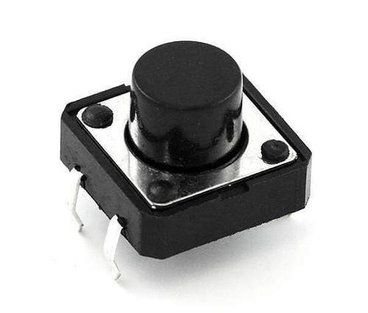
Push button
It is an incomplete switch used to operate an electric device.

Slide 6
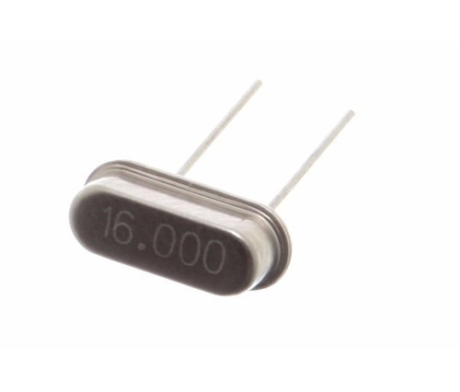
Crystal oscillator 16MHz
It is an electric oscillator type circuit that uses piezoelectric resonator, a crystal as it’s frequency-determining element.

Slide 7
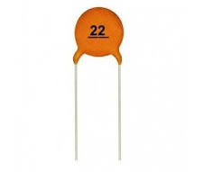
22pf Ceramic capacitor
Ceramic capacitors consists of two or more alternating layers of ceramic material as the dielectric and metal layers acting as the non-polarized electrodes.

Slide 8
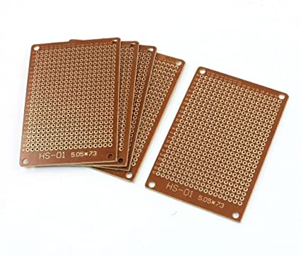
Varo board/strip board
It is an prefound circuit board material of copper strips on an insulating bonded paper board. It is manufactured from copper clad laminate board or epoxy based substrate.

Slide 9
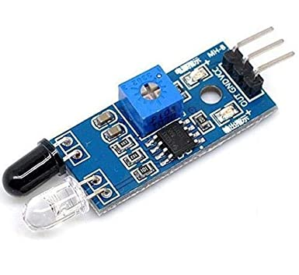
IR sensor.
It is a radiation sensitive optoelectronic component with spectral sensitivity that decode the pulses of light into binary data that the device’s microprocessor can understand.

Slide 10
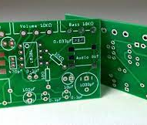
PCB
A printed circuit board is a non-conductive material with conductive lines printed or etched. Electric components are mounted on the board and the traces connect the components together to form a working circuit.

Slide 11
THANK YOU
For your attention….

